Slide 1
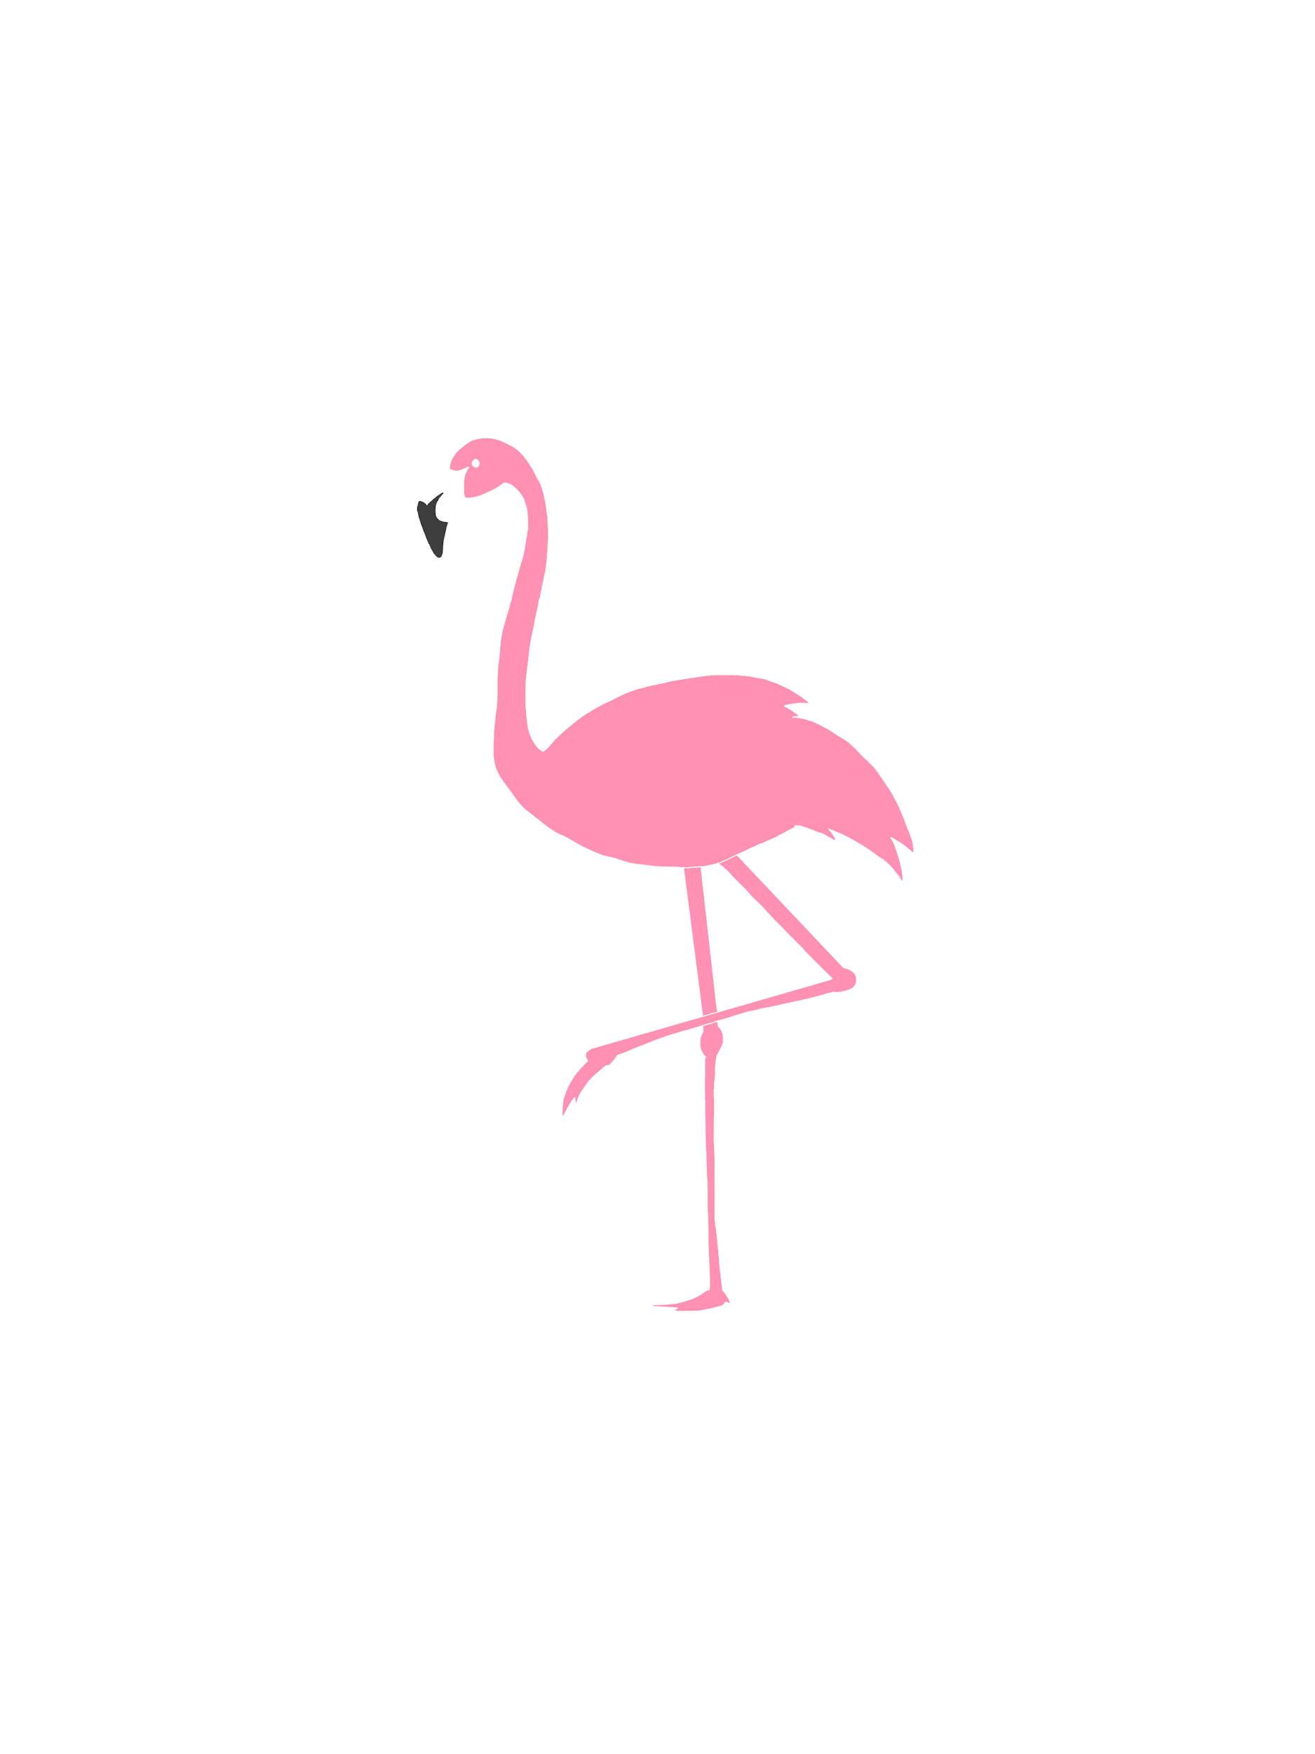
How can we increase revenue
from
Catch the Pink Flamingo?
Nima Afshari
Eglence Inc.
Notes:
This data-driven analysis is presenting as a consultation document of how to make high-level decisions
about budget allocation in Eglence Inc. for maximizing the profit from the game catch the pink flamingo.
The data is from game history of various players at different times and can be considered as an unbiased sample.

Slide 2
Problem Statement
Type of available data for the analysis:
Datasets related to users’ interactions with the game including sessions, purchases, clicks, team data, platform, etc
Chat data between users in teams, how they are interacting and join an left to the groups
Notes:
The users’ experience is a crucial part of every application. Most of the money-related decisions of users can be changed through different level of user experience and how they interact with the app. Hence, analysis this UX/UI data is an essential part of every app analysis process. On the other hand, users are contacting to each other in the game and join in groups. This is another important part of data, because of their group behavior and how they impact other person’s decisions. For instance, some groups may be more active in in-app purchasing, while the other more active in sharing the app to their friends. Identifying those will lead to better business related decisions.
Fill in appropriate/key data set descriptions.
In your script, be sure to make clear how this is a data science story. State in your own words YOUR opinion of why the different kinds and sources of data are so important for Eglence to be able to identify new revenue opportunities.

Slide 3
Data Exploration Overview
Key findings during data exploration:
Based on Items available to purchases:
Some are more interesting for the users like item 2
Some generates more total money like item 5
Raking the users based on total amount of purchases can lead to better focus on more spender needs
Notes:
Exploratory Data Analysis shows that some items attract more users to buy them, and some other items generate more money based on their price. There are a variety of decisions that can be made regarding each category. For example, lowering the price of unattractive goods, or do changing the marketing methods for them to see if their unpopularity is intrinsic or not. Another decision can be made about the purchasers, to put more effort on finding and satisfying their needs.

Slide 4
What have we learned from classification?
Separation between HighRollers and PennyPinchers:
A classification task that distinguishes two important class of app users.
Decision tree classifier with Gini index as impurity measure
Classes are based on money spent on a single item (avg $5)
Turns out that HighRollers are basically users with Iphone platform
Notes:
Separation between high spenders (HighRollers) and low spenders (PennyPinchers) is the most essential part of this analysis. Its purpose is to find the money spending pattern of a user based on their activity in the app. This task has been accomplished through training a decision tree classifier using Gini-Index as its impurity measure. The analysis shows that the most important feature that can demonstrate the user’s spending pattern is their platform. Basically, Iphone owners are spending more money in the app rather than other platforms.

Slide 5
What have we learned from clustering?
Using clustering to find more specific relation between groups of users:
A K-means clustering with 3 clusters is used based on the selected features
Features include:
Total number of ad-clicks per user
Some of the money spent on all ad categories by each user
Game clicks per hour by each user
Notes:
As there is no exact rule to show the best classes to separate users, a clustering algorithm could make the analysis more concise. A K-means clustering algorithm with 3 clusters and above features is fitting to the data, and it turned out three classes of users. Cluster 1 they are the best to expand the app with their friends and the company can plan on incentives for them. Using any sort of marketing with this goal seems reasonable. Cluster 2 They like to buy online materials and they are spending money on the ads and in-app purchases. Targeted sales funnels will work best for this cluster users. Cluster 3 The company should make some in-game incentives for these users to attract them for clicking more on the money-making ads

Slide 6
From our chat graph analysis, what further exploration should we undertake?
Exploring chat data is important because of social behaviors of users:
Graph analysis shows that users act in some way like their groups
Identifying each group needs can lead to better decisions
For example the most chattiest user are part of the most chattiest groups
They can be targeted as active users for any kind of marketing of the product
Also these users can be targeted for arranging the app atmosphere to be more competing and interesting
Notes:
This chat data model is created using Neo4j graphic tool from six chat data csv files. The data contains information regarding users, teams, team chat sessions, chat items, chats and timestamps to support node creations. It provides data to build relationships for creating chats, joining teams, leaving teams, mentioning teams, and responding to chats. From this graph model, we perform various analysis on player behaviours. The first step is to use Cypher query to load six chat data csv files into Neo4j. The queries create nodes and edges when each file is loaded. After the chat data is loaded, we perform various queries to find the longest conversation chain using the "ResponseTo" edge label and participants in this conversation; who is chattiest users are in the chattiest teams by analyzing the User, ChatItem, Team nodes and PartOf, TeamChatSession edges. Finally, we find the most active users by using cluster coefficient. One mentioned another user in a chat; One created a chatItem in response to another user’s chatItem. The analysis can benefit Eglence Inc. by targeting the most active users for revenue generation in the Flamingo Game. In this exercise, getting used to the Cypher queries are very important when needed to get information from graphic database in Neo4j.

Slide 7
Recommendation
Putting some effort on Native iPhone apps and make the app faster and more fancy to make the users attracted to spend more time in it. Spending more time in the app can lead to engagement and hence more purchasing.
Starting some sales funnels specifically for iPhone users to elevate the number of them. This would lead to more HighRoller users and more revenue for the company.
Based on the clustering analysis, some recommendations have given for each cluster
Target the chattiest groups and users for making your app atmosphere more competing
Notes:
Since iPhone users are the biggest spenders, Eglence Inc. can release more in-app advertisements targeting iPhone users. For example, Eglence Inc. can introduce more team playing events in the Catching the Flamingo Game. In these team plays, users can utilize iPhones' microphone and camera to coordinate in chasing and catching flamingos. When users are playing in a team, prompt some strategies and associated tools for the team to catch flamingos. Eglence Inc. will increase revenue when these active players perform in-app purchases.

